Slide 1
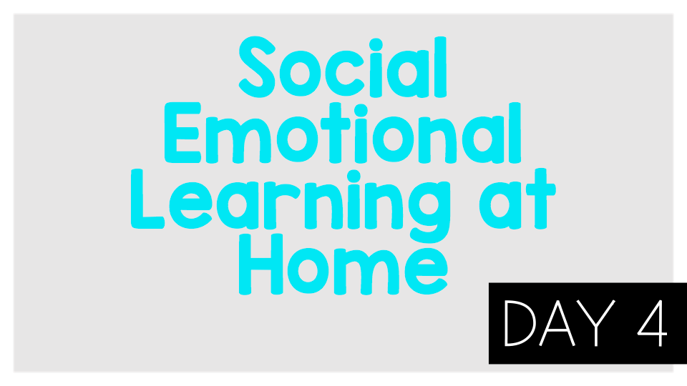
Worry lesson 1

Slide 2
Think:
1.What are some of the worries Wilma Jean has? Can you relate to her worries?
2.What happens to Wilma Jean when she worries?
3.What did Wilma Jean’s teacher do to help Wilma Jean with her worrying?
4.Why is sorting our worries (like Wilma Jean’s teacher did) helpful?
Do:Make a list of your worries you can control and those you can not control.

Slide 3
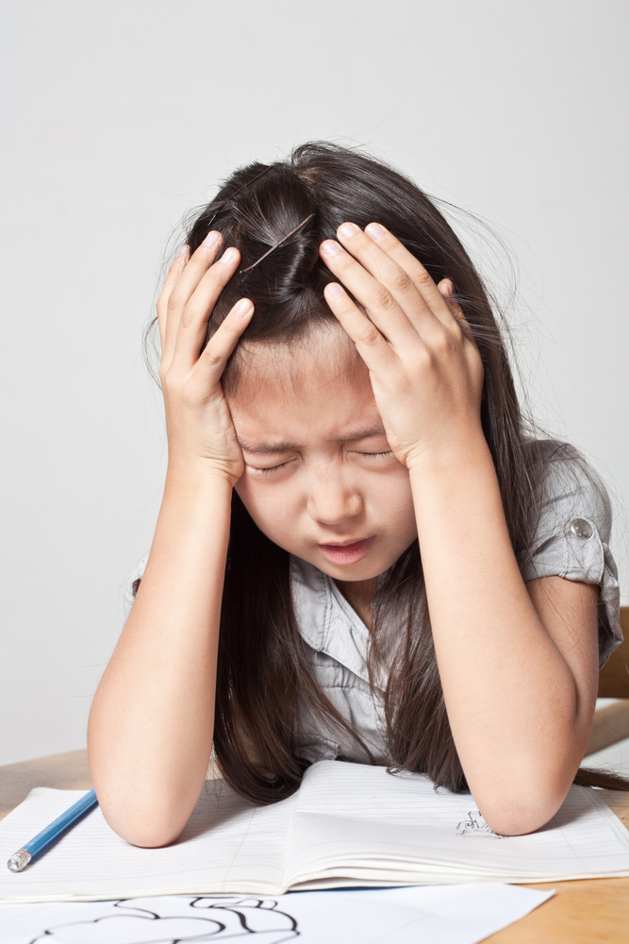
Activity:
Write/Draw something you worry about. Why do you worry about it? How does it affect your life? Is it something you can control? What are some steps to take to help with this worry?

