Slide 1
Weaving Narration through Stories
Once Upon A Time

Slide 2
When I was little, I watched the movie Pinocchio. There was this little cricket guy named Jiminy Cricket who came on screen, wearing a top hat and coat and carrying a cane. At various times in the
story, he would talk right to those of us
watching the movie. He’d say things like, “One
night, a long time ago, my travels took me to…”
or he’d say, “Of course, I’m just a cricket singing
my way from hearth to hearth, but let me tell
you what made me change my mind…”

Slide 3
Now, as a grown-up, I know that the fancy word for that little cricket guy is narrator. You all know about narrators. When you read a book, you notice when characters say words, and all the other parts are the narrator.

Slide 4
I’m telling you this because if you read a ton of fairy tales, you quickly realize that many of them have a Jiminy Cricket character in them - a narrator who comes out on stage and makes a little speech to readers. Let’s look at this piece from Prince CInders by Babette Cole.
Prince Cinders was not much of a prince.
He was small, spotty, scruffy and skinny.
He had three big, hairy brothers who were
always teasing him about his looks.

Slide 5
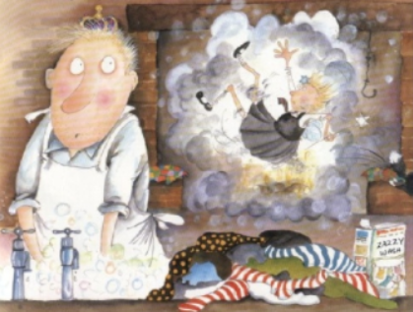
Then the narrator stops saying his lines, and the small moment story takes over.
One Saturday night, when he was washing his socks, a dirty fairy fell down the chimney.

Slide 6
Here is another, from Cinder-Elly by Frances Minters
Once upon a time,
Or so they tell me,
There was a girl
Called Cinder-Elly.
Elly was good
And she was pretty.
She lived with her folks
In New York City.

Slide 7
And again, the narrator’s part ends and the story starts.
But then one day
El got a note.
So did her sisters.
Somebody wrote...

Slide 8
Today I want to teach you that writers of fairy tales use narration, or telling, in some important ways: to introduce the story, to stitch one scene to the next, and to end the story.

Slide 9
The first place where writers of fairy tales use the power of telling is at the beginning of the story. Fairy tale writers often start by almost coming on stage, talking to readers, filling them in on the background of the story.
For example, the classic Cinderella tale does not begin in the ways you’ve learned to begin a story, with a small moment and a character who is saying or doing something.

Slide 10
Cinderella isn’t even out on stage at the start of the classic version. Instead, it is as if a narrator comes out on stage and gives the reader a little speech, explaining some of the background to the story. The narrator tells the readers,
“There once was a man whose wife died and so he took another. The new wife was proud and haughty, and had two daughters who were just like her in every way. But the man also had a daughter, and she was sweet and gentle and good as gold.”
Did you see how the narrator pops in like Jiminy Cricket and gets the story going?

Slide 11
And that’s not the only place that writers use narration. The narrator is also used to stitch the scenes, the small moments, of a story together. Usually, there is a jump-in time and place between one small moment and another, and the narrator of the story - the Jiminy Cricket - comes out on stage and talks directly to readers, saying,
“After this, a bunch of time went by. Then one day, in this other
place,” and then readers are back into the second small
moment story.

Slide 12
In fairy tales the narrator often uses fancier words to stitch scenes together, like they might say,
“After some months had passed, the king’s son gave a ball for all the stylish people in the countryside” and “For two days the sisters could hardly eat for excitement” and “At last the evening of the ball came.”
The important thing for you to know is that another powerful
way to use narration is to stitch together small moment stories
so that readers understand how they fit together.

Slide 13
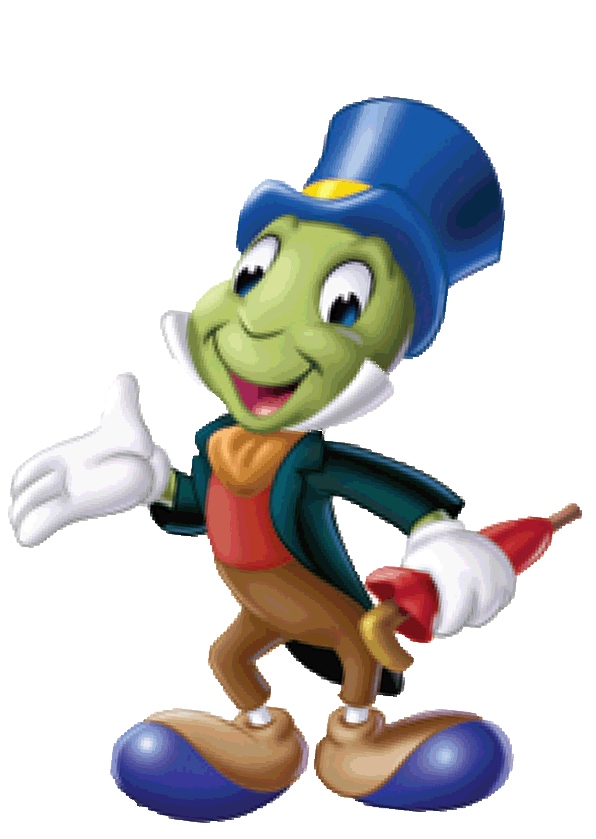
The Power of Narration
Provides backstory at the beginning of a story.
Stitches together small moment stories.

Slide 14
Let’s try using these two kinds of narration in our class adaptation of Cinderella. We haven’t finished drafting all of our scenes yet, but I think we have enough of a start to practice.
Think of what narration you might add at the start of our Cinderella story to provide readers with some backstory. You can write it on some paper from your notebook.
Think about and jot a way that you could use the narrator to stitch together scene 1 and scene 2. Readers might be confused by how Cinderella gets from the laundry to her attic.

Slide 15
Let’s add some of narration to our class story.
Here is our beginning:
And here is what we can use to
stitch scenes 1 and 2 together:
Once long ago, in a land far away, there lived a girl named Cinderella. Cinderella tried to be cheerful, but it was kind of hard. She lived with her evil stepmother and two mean stepsisters. They made Cinderella work all the time. All she wanted to do was read.
Later that night, as she sat in her room, Cinderella...

Slide 16
In just a couple of sentences, we used the power of narration to give readers backstory at the beginning and to stitch together two scenes!

Slide 17
Today you will have time to do some of this work, and all the rest of the work you need to do, in your own fairy tale adaptations! Before you leave, think about the narration you can add to your story. When you add the voice of the narrator, your story becomes a story rather than just a collection of wonderful scenes.
Add narration to your story.

Slide 18
Listen to the ending of the classic Cinderella.
Cinderella was taken before the prince. He was overwhelmed with love for her and some time later they were married. Cinderella, who was as good as she was beautiful, gave her two sisters a home in the palace, and that very same day they were married to two lords of the court.
It’s kind of like Jiminy Cricket coming back onstage one last time to tell us a few things we need to know about how everything fits together in the end.

Slide 19
When you draft your endings today, try this. We can add this third kind of narration to our chart, too.
The Power of Narration
Provides backstory at the beginning of a story.
Stitches together small moment stories.
Wraps the story up at the end

Slide 20
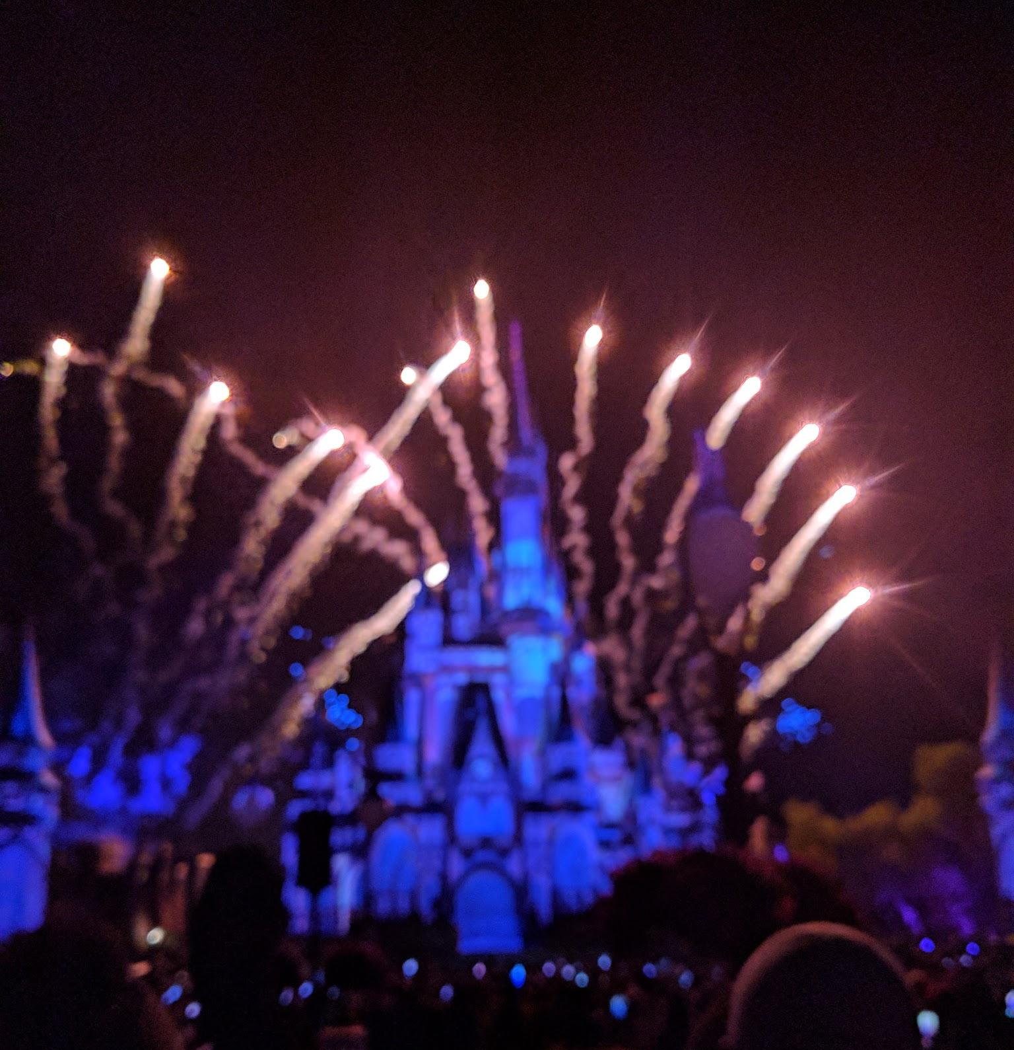
Writers, you have worked hard to draft your endings. You have learned a lot about endings in fairy tales. You know it is important that the character’s problems get solved, and let the the reader know the story is over.
It helps to share endings with a friend or a
partner, and getting their reaction. So today,
send your paper to your teacher to see if the
ending is doing its job.

