Slide 1
Writers Can Story-Tell and Act Out as They Draft
Once Upon A Time

Slide 2
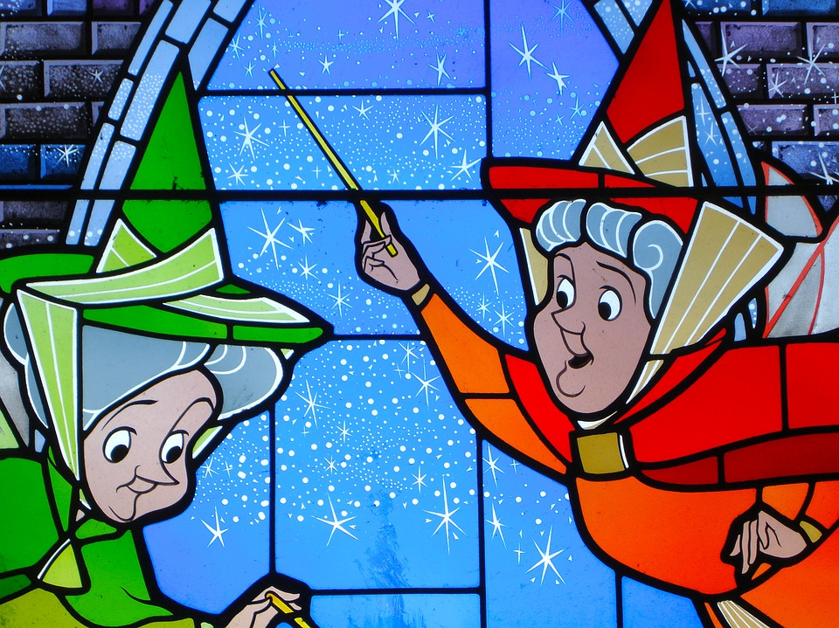
Writers, like you, I am thinking about what will happen next. Our class story needs to jump ahead now, probably to the part where the fairy godmother comes.
Yesterday, you spent some time thinking about what your next scene, or small moment will look like. Let’s do that now with our class story.

Slide 3
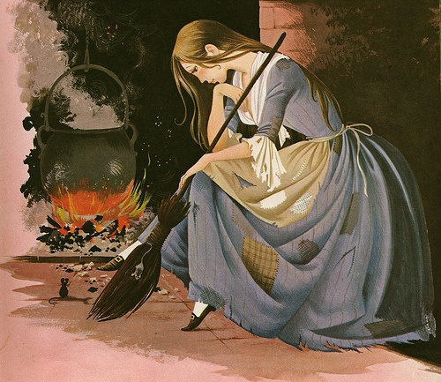
So we know the fairy godmother comes, but where does she come, and how? And when she comes, is Cinderella still folding laundry in the same place, or has the scene changed?
I know in the original story, Cinderella
is by the hearth, cleaning up the ashes…
hmm…

Slide 4
We have to ask, “What will happen next?” and “How might the scene go?” Let’s list some possible ideas.
Cinderella, in her bedroom/in the basement laundry room? Crying.
Her fairy godmother comes down the chimney?
Cinderella wants a bike and clean clothes to get to the fundraiser - gets them.

Slide 5
Today I want to teach you that when you are writing, you can rehearse in the middle of writing as well as at the start of it.
And specifically, when writing a fiction story that contains several small moments or scenes, it helps to storytell or to act out each small moment before writing it - or at least to do this while writing it.

Slide 6
Because you are all storytelling, or acting your story to get ready for writing it, I’m going to give you a few acting tips. The first tip is when you act, you need to not only show what the character says, but also what the character does. Even tiny little actions may make a big difference.

Slide 7
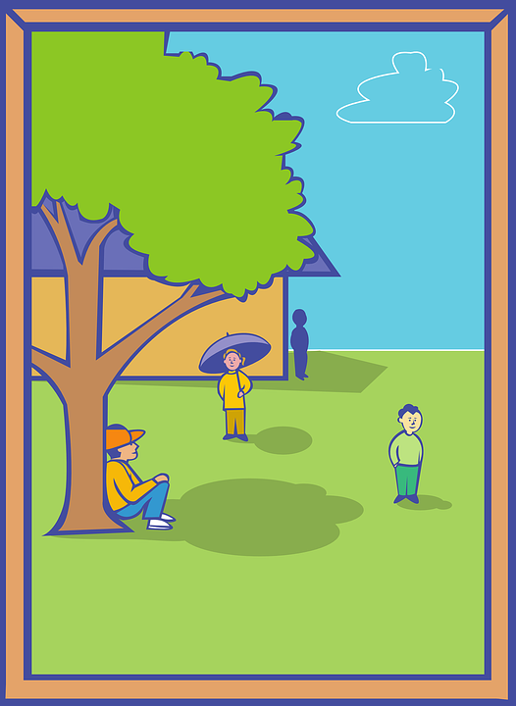
The second tip is this. When you are acting, or writing a story, you not only bring some characters to life - say, a girl and a wolf - you also bring a place to life. Always make sure you know where, exactly, your character is, what the things are that are nearby, and what the place feels like.

Slide 8
So let’s try doing some acting with our Cinderella story, first, and then you may try with your own stories. Remember - you are working on the second scene of your story.
Play the part of several characters on the next slide. Be dramatic.

Slide 9
“Stop crying, Cinderella. I am your fairy godmother, and I am here to grant you a wish.”
“Wh...at? Who are you?”
“You want to go to the fundraiser for the library, and I have the magic to make that happen. Let’s see, you’ll need…”

Slide 10
Any suggestions for how your acting could improve? Remember, acting helps bring the characters and places to life.
Did you add in enough actions?
Did you show enough about the place?
Hmm… I need to think about what objects we might be holding, and also what the place might feel like. Let me try again.

Slide 11
“Stop crying, Cinderella. I am your fairy godmother, and I am here to grant you a wish.”
Remember you have a pile of laundry in front of you!
“What? Who are you?”
“You want to go to the fundraiser for the library, and I have the magic to make that happen. Let’s see, you’ll need…”

Slide 12
Writers, or should I say actors, the acting you just did helped discover different ways to bring the characters and place to life. Little, tiny actions make a big difference once we add them to our writing, like the twirling of a magic wand or Cinderella falling back in amazement. Let’s add these details to our class story!

Slide 13
Okay, time to try this in your own scenes. Decide what is happening in your next scene, and then try acting it out.
You can use your writing organizer to help if needed!
Get started!

Slide 14
When a person writes, they act in their mind the story they will write. That is, when you write, it helps to be acting the story out with your body or in your mind as you rush to get it onto the page.

Slide 15
Right now, go back to the start of this scene in your writing. Picture what you just acted out. Or picture what you could act out. Who is saying what? What is that person doing? Picture what that person is holding, where he or she is. You got it in your mind?
Then start writing! Go!

Slide 16
Let’s think about how endings to stories usually go and then try out a few ways our story could end. Let’s think about how the classic Cinderella story ends that solves Cinderella’s problems and helps us feel the story is over.
The first thing we should do is list what happens at the end.
The prince finds the lost slipper.
He travels around the kingdom having everyone try on the slipper.
At last, Cinderella tries it on, and it fits perfectly.
Cinderella marries the prince and they live happily ever after.

Slide 17
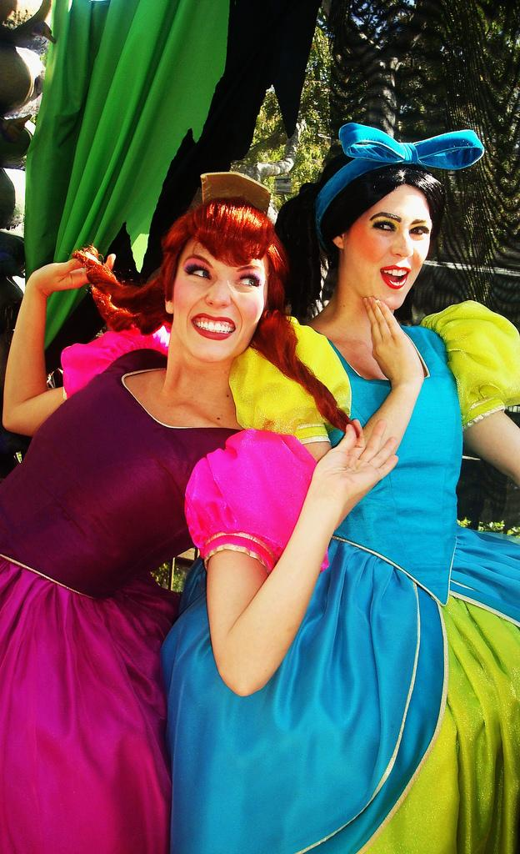
What happens at the end that solves Cinderella’s problems?
1. The ending fixes Cinderella’s problems by letting her marry a prince because at the beginning she is so lonely.
2. The ending solves her problems because the evil stepmother and stepsisters get sent away. Both of those problems do get solved in the classic tale!

Slide 18
To write an effective ending, we not only need to write an ending that’s different from what happens in the classic tale, but also we need to write an ending that solves the big problems that we have created for our story, our Cinderella.
What were Cinderella’s problems in the beginning?
“How does this ending solve our Cinderella’s problem?”

Slide 19
Now, think about how you might end your story. Storytell or act out a possible ending or two to your fairy tale. Use what you know to make your final scene come alive!

