Slide 1
Storytelling, Planning, and Drafting Adaptations of Fairy Tales
Once Upon A Time

Slide 2
By now, you are experienced enough that you can tell me, not the other way around, what you need to do first to get started writing your actual stories.

Slide 3
I’m pretty sure you already know you need to rehearse. What are some ways narrative writers can rehearse?
Story-tell to each other.
Sketch out or act out what happens.
Think what is first, next, next.
Make a timeline.
Try different leads!

Slide 4
Today I want to remind you that the real goal when you rehearse for writing a story is not to come up with something to say, but to make the story you will write much stronger.
If you story-tell and act out your story, your rehearsal brings your story to life.

Slide 5
I’m going to use it to tell just one scene.
So - next we need to think about our first scene. We have figured out Cinderella will be doing some kind of work for her mean stepsisters and then a letter arrives about a meeting to plan to save the town library.

Slide 6
Right now, list what is going to happen in this first scene - in detail. We know Cinderella is working, but what is she doing, exactly? Is she sitting? Standing? Who is near her? Who says what? Plan what happens first, then next, then next… across your fingers. Go!

Slide 7
“Cinderella is doing a job, like laundry, and then someone comes with the invitation to the library thing, and third, the sisters throw it away, and fourth, Cinderella says she wants to go, and fifth, they laugh at her.”
Story-tell in ways that show what Cinderella is doing, and then who says or does what. Go!

Slide 8
What great storytelling! There are details filled in. Who knows what people will say after the doorbell rings? And what have you added to show that the stepsisters are mean to Cinderella?
Let’s add to our story!
One sunny afternoon Cinderella was folding her stepsister’s gowns. She had a whole mountain of more laundry to fold. Then all of a sudden the doorbell rang.

Slide 9
Remember, Cinderella is slaving away, and the stepsisters treat her horribly. Make sure those big things shine through your version. After you retell, keep going in the story, remembering to include specific actions and specific things people say.
One sunny afternoon Cinderella was folding her stepsister’s gowns. She had a whole mountain of more laundry to fold. Then all of a sudden the doorbell rang.
“You lazy girl,” the mean stepsister said to Cinderella. “Go get the mail. Hurry. Don’t waste time.”
Cinderella went to the door.

Slide 10
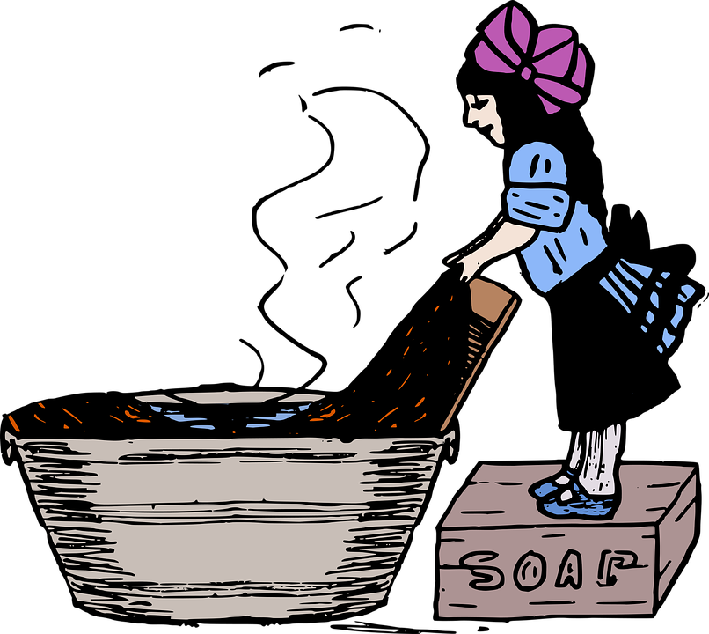
The stepsister could growl at Cinderella and shoot angry looks at her.
Now we are going to make our storytelling even more powerful. Pretend to be Cinderella - acting her out
Add in a little bit of movement - some
gestures, some of the small actions that happen as the
first scene begins. Pretend to be one of
the mean stepsisters.

Slide 11
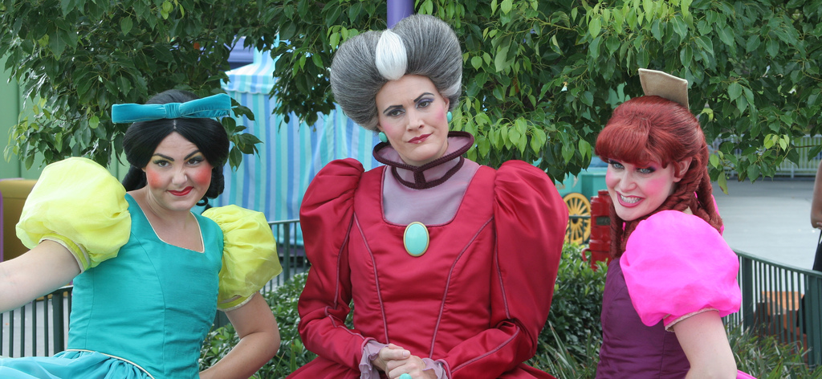
As you act out the scene, pay attention to the little actions you add when the character speaks. Also think about how they talk.

Slide 12
I hope you can see how storytelling and drama can help you bring a story to life. Now our job is to take that storytelling and acting and put it onto the page, onto drafting paper. I’d probably start with something like this...

Slide 13
One sunny afternoon Cinderella was folding her stepsister’s gowns. She had a whole mountain of more laundry to fold. Then all of a sudden the doorbell rang.
“You lazy girl,” the mean stepsister said to Cinderella. “Go get the mail. Hurry. Don’t waste time.”
Cinderella went to the door. When she opened it, no one was there. She looked left, right, and then down. There on the doorstep was a letter.
“Well,” said her stepsister. “Who’s there and what do they want?”
Cinderella picked up the letter and handed it to her stepsister. “It’s an invitation. From the town’s mayor! It says, “Save the library” on the envelope.
Her stepsister looked at Cinderella and smirked, “I don’t know what you’re getting excited about. You’re not going anywhere dressed in rags and dirt. And besides,
who cares about a library?” She ripped the invitation in two and threw it in the trash. “A library? How ridiculous.”
Cinderella returned to folding her mountain of laundry. “It’s not ridiculous,” Cinderella thought. Taking a deep breath, Cinderella said, “May I go?”

Slide 14
Try this with your own story. Start by retelling the beginning of the classic tale, writing on notebook paper. Some of you may want to start on Office 365.
Next, make sure you get the facts straight about what will happen in your opening scene, your first small moment story. Who is doing what, exactly?
Remember, we had Cinderella doing something, and then something is said, or something happens - for us it was the stepsister getting mad at Cinderella, and then the doorbell.

Slide 15
Right now, think about who is doing what and saying what in your opening scene, in your first small moment. Be specific - we had to decide exactly what kind of work Cinderella was doing, and you will need to make decisions like that too.
When you are ready, storytell
your scene. Show and tell what your
character is doing, and who
says what.

Slide 16
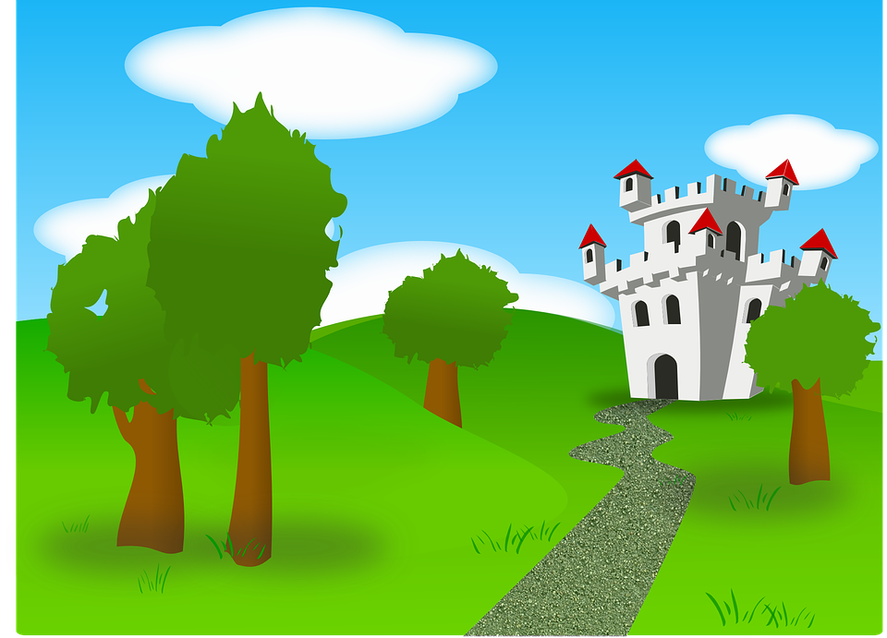
Writers, I like how you slowed the scene down, acting out what the characters were actually saying through dialogue and storytelling exactly what the characters saw. I can’t wait to see that appear in your writing.
We are on the brink of writing time.
Get a clean piece of paper ready!
With your opening scene fresh in your
mind, start drafting it!

Slide 17
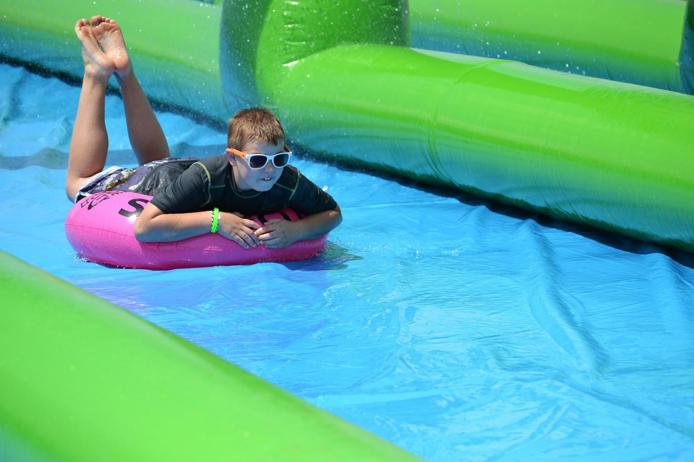
Writers, I am so impressed with the amount of writing you are doing. I love that you have been writing fast and furiously.
I want to caution you that some of
you are slip-sliding into the next
scene of your story. Chances are
you may not even notice it.

Slide 18
Will you reread your story, and see if you are still
writing within the first small moment - or did you
step on the gas and go vrooming to other parts
of the story?
If you went past the opening, will you draw a line on your draft where the first small moment ends? Your first scene should be about a page in length. If you only have 4 or 5 sentences, you will need to add more details!

Slide 19
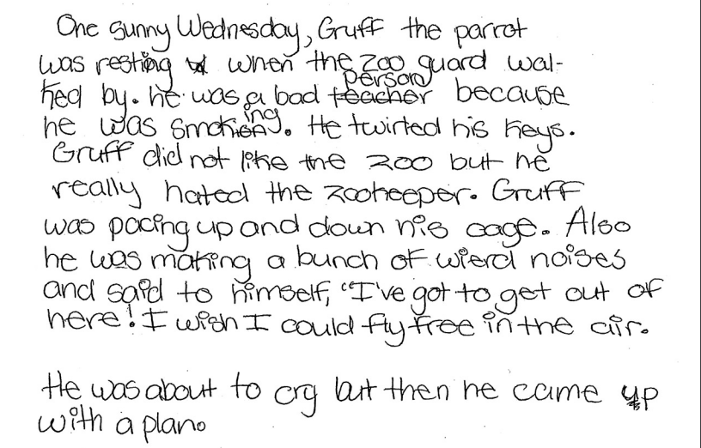
Writers, you’ve each written the first scene, or small moment in your fairy tale adaptation. Let’s study this opening by a student named Sam. Let’s see if we can notice specific things Sam does to storytell his scene in ways that allow us to picture the unfolding story.

Slide 20
What has Sam done that you admire?

