Slide 1
Adapting Classic Tales
Once Upon a Time

Slide 2
Whenever I read a fairy tale, I think about the fact that before fairy tales were ever written down, they were told and retold, time and time again, in different ways!
They’ve been told and retold, passed from one person to another, because they work as stories. Fairy tales are our most beloved stories of all time.

Slide 3
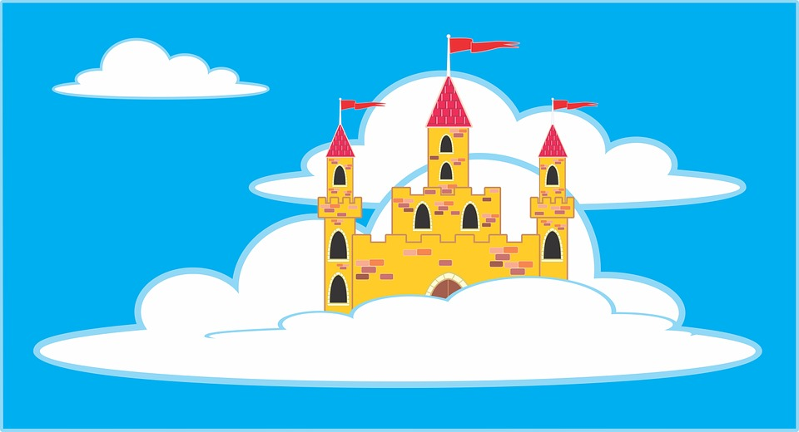
Today we are going to start learning about fairy tale adaptations.
Writers write adaptations all the time. They take a classic story and they write a different version of it. Writers call this kind of writing an “adaptation.” Although writers adapt all sorts of stories, there is one kind of story that writers especially adapt - fairy tales!

Slide 4
We need to know how to write a fairy tale adaptations.
Watch Writing Lesson: Fractured Fairy Tales
https://www.youtube.com/watch?v=2f34wjFQy3s

Slide 5
I do not know how authors go about adapting fairy tales, but I do know how to answer that question. When we wanted to know how information writers write leads, we read information books! So… I am thinking if we want to know more about adapting fairy tales, then we should read some adapted fairy tales!

Slide 6
Read The Three Little Javelinas
https://www.youtube.com/watch?v=JbUQpUKinKA

Slide 7
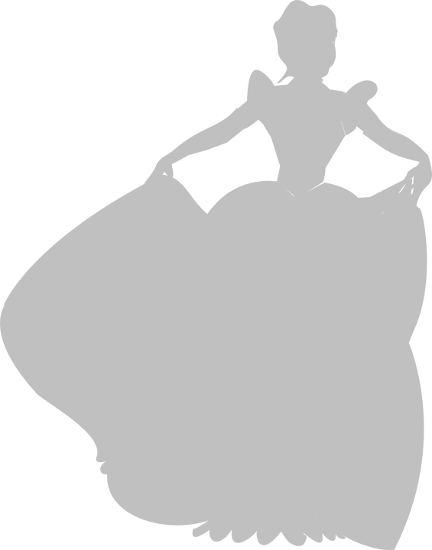
I know you have heard the adaptation of Cinderella, Prince Cinders by Babette Cole. Let’s look at that adaptation again and think, “When this author adapted the original story, what did she change?” And also, “What does the author seem to be trying to do when they changed some things and not others?”

Slide 8
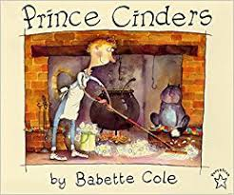
Looking at the cover, what do you notice?
The author changed the main character from a girl to a boy.
Let’s see how many changes we can find, and think about why the author made those changes.

Slide 9
Let’s pause and think about why Babette Cole might have changed Cinderella from a girl to a boy. Hmm….. why would she do that? I am not sure.
Oh well, I don’t know the answer so I should probably just move on. Too bad we can’t just call Babette on the phone and ask her.
So class, we do not know what exactly was in Babette’s mind when she turned Cinderella into a boy, so what do we do? Give up? Say, “Oh well?”

Slide 10
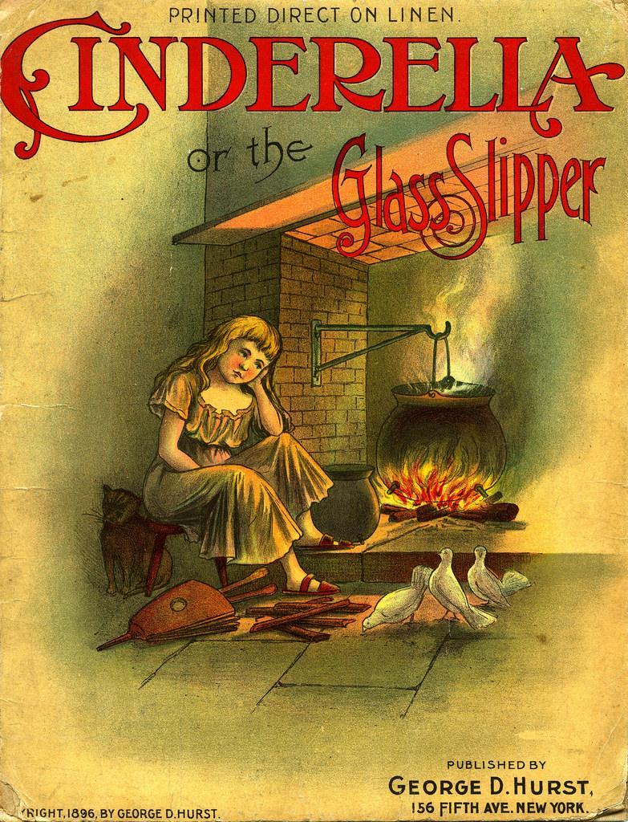
Some of you may think that she made the change of the character because often people think Cinderella is a girls’ book, and Babette may have wanted to show that Cinderella is for everybody.
That would be an important reason to
make a change too!

Slide 11
Let’s start making a chart together. We can list things we notice along the way.
Ways Authors Adapt Fairy Tales
Changing the character
From a girl to a boy

Slide 12
Let’s read on, and this time be ready to make your own additions to our list in your notebooks.
“Prince Cinders was not much of a prince. He was small, spotty, scruffy and skinny. He had three big hairy brothers who were always teasing him about his looks. They spent their time going to the Palace Disco with princess girlfriends. They made poor Prince Cinders stay behind and clean up after them. When his work was done, he would sit by the fire and wish he was big and hairy like his brothers. One Saturday night while he was washing the socks, a dirty fairy fell down the chimney.”

Slide 13
Babette’s fairy godmother is a dirty fairy. Let’s add that to our chart.
Ways Authors Adapt Fairy Tales
Changing the character
From a girl to a boy
From a fancy godmother to a less fancy one (dirty one)

Slide 14
Writers, I am going to let you in on a secret. When you make a theory or two about why an author did something, even when it’s not totally right, helps your own writing.
The theories you invent about how and why authors adapt fairy tales will fuel your own writing work. So keep taking notes!

Slide 15
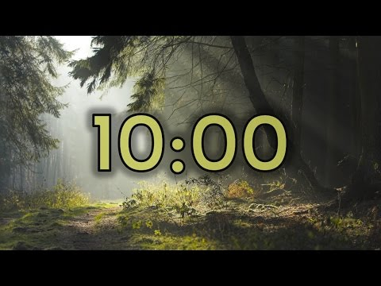
It will also be helpful to pay attention to
the fact that a lot of things stay the same
in an adaptation. The trouble is usually
the same. For example, Prince Cinders
still wants to go to the event where his
brothers are and he still cannot go
because he’s home doing chores.

Slide 16
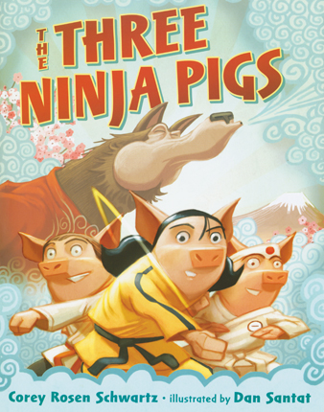
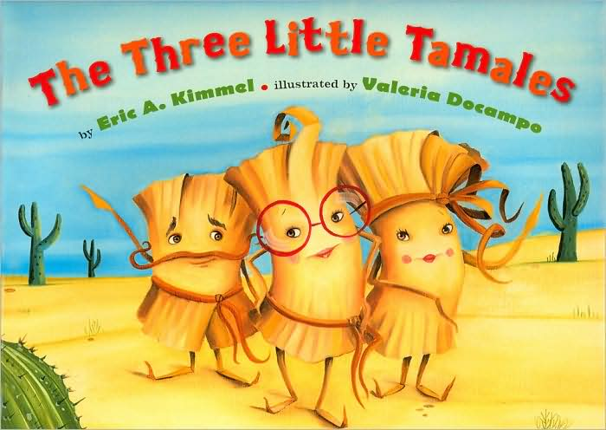
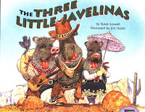
Tomorrow is an exciting day ! You’re actually going to start working on your very own adaptations. Everything you have noticed so far about adaptations will be very helpful.
You will be writing an adaptation of The Three Little Pigs. You may even have some ideas in mind for adaptations!
I can’t wait to see what you will come up with.

