Slide 1
Writing Story Adaptations that Hold Together
Once Upon A Time

Slide 2
Let’s start today by thinking about yesterday’s realizations. When writers adapt fairy tales, what do they change? And most importantly, why do they make those changes?
Think to yourself about the changes you found yesterday, and why you thought they made them.

Slide 3
Use the list to help you adapt The Three Little Pigs
Ways Authors Adapt Fairy Tales
Changing the character
From a girl to a boy
From a fancy godmother to a less fancy one (dirty one)
Changing the events
From something old fashioned to something modern.

Slide 4
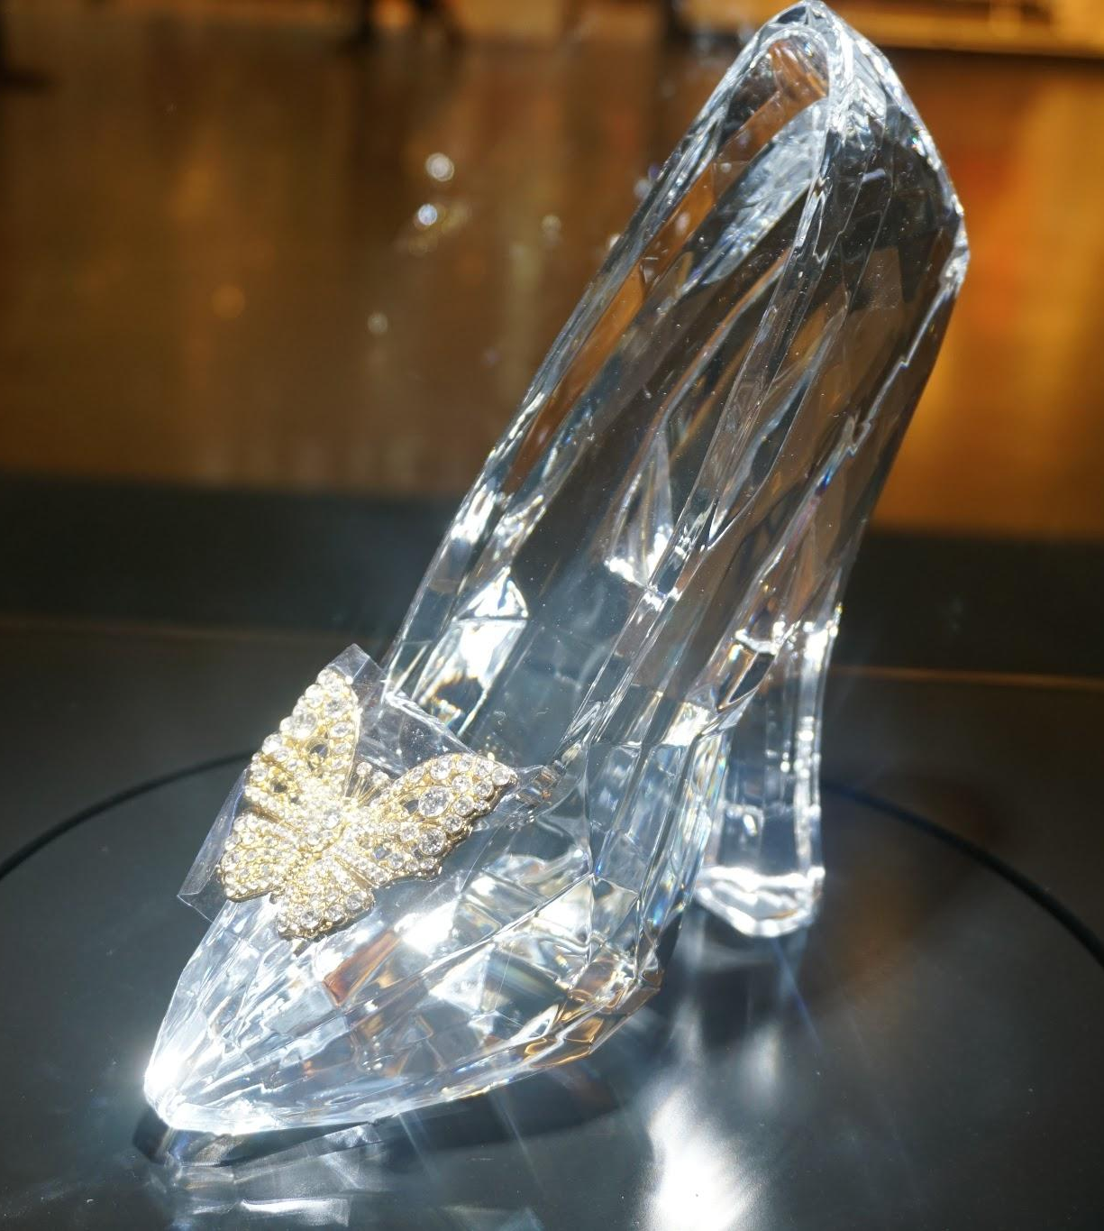
Writers, many of you are talking about the fact that when a writer makes a change - say changing Cinderella from a girl to a boy - that one change changes other things, right?
For example, the author had to change Cinderella losing a glass slipper to Prince Cinders losing his pants!

Slide 5
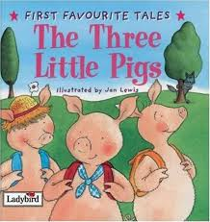
When an author makes one change, it is like a domino that falls over and pushes other things to change.
So what if we decided that too often the main characters in fairy tales are farm animals, and it would be better if the characters were household pets.
How might that affect a story like The Three Little Pigs?

Slide 6
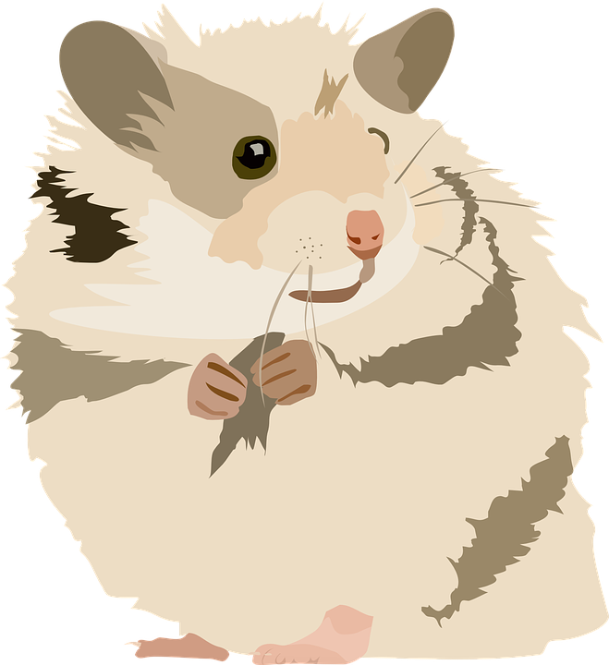
What if it was called The Three Little Hamsters?
If they were hamsters, would they still build houses?
Would it still be a big, bad wolf that terrorized the hamsters?
Think about the changes that might be made.

Slide 7
A cat would go after the hamsters.
The cat wouldn’t say, “I’ll huff and I’ll puff,” he would say, “I’ll hiss and I’ll scratch.”
This leads me into what I want to teach you today!

Slide 8
Today I want to teach you that when writers plan how an adaptation of a story will go, they do two things.
1. They decide on a change that they think will improve the story.
2. They make sure that the change leads to other changes so the whole story fits together.

Slide 9
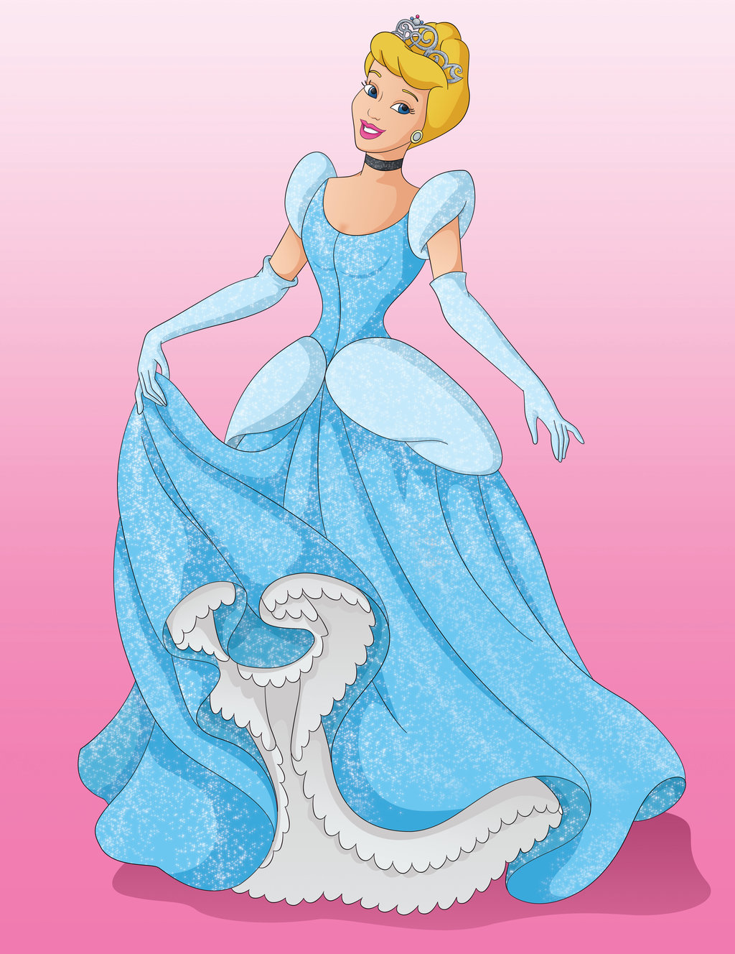
I know yesterday you did some thinking about The Three Little Pigs, the fairy tale you will adapt.
I will be writing an adaptation of Cinderella.
Before a person can think about a possible adaptation,
it helps to have the original well in mind.

Slide 10
I am going to list in my mind the main things that happen in Cinderella; will you do the same for The Three Little Pigs?

Slide 11
Now comes the hard part. We need to think - what is an important way we could change the elements of this story to make it better? I usually start by thinking, “Is there a part or aspect of the story that I don’t really agree with, the way it is now? Is there a reason to change the story?”
Let’s start by recalling the main events in
Cinderella.

Slide 12
Cinderella is mistreated by her stepmother and her stepsisters. She has to do all the work.
An invitation comes to a ball at a palace; they tell Cinderella she has to get them ready for the ball and then to stay home, cleaning the ashes out of the fireplace.
A fairy godmother gives Cinderella a fancy dress and a fancy pumpkin carriage so she looks like a fancy princess. The magic will go away at midnight.
Cinderella goes to the ball and dances with the prince.
At the stroke of midnight, she runs out, leaving a glass slipper, which the prince finds.
The prince searches for the owner, finds Cinderella. They get married and live happily ever after.
So let’s think about a big reason to change this story.

Slide 13
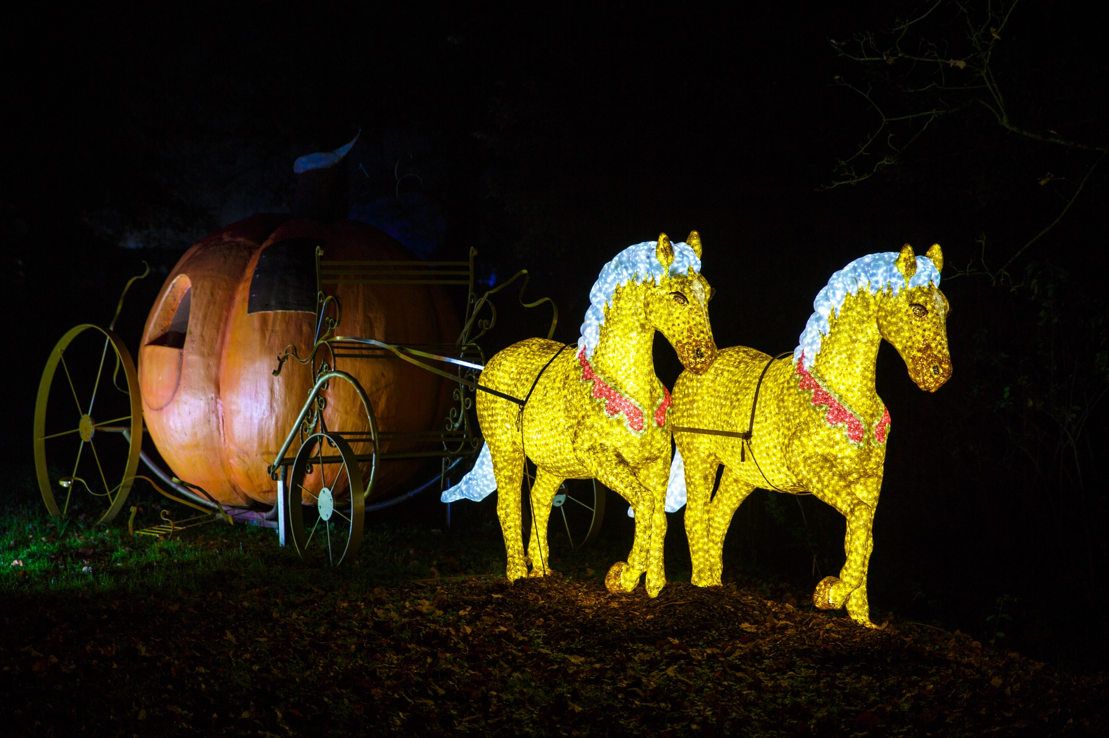
It’s about this girl, who wants the fancy dress and the fancy car so she can get the fancy prince…
What might not be so great about this story, and what you might change?

Slide 14
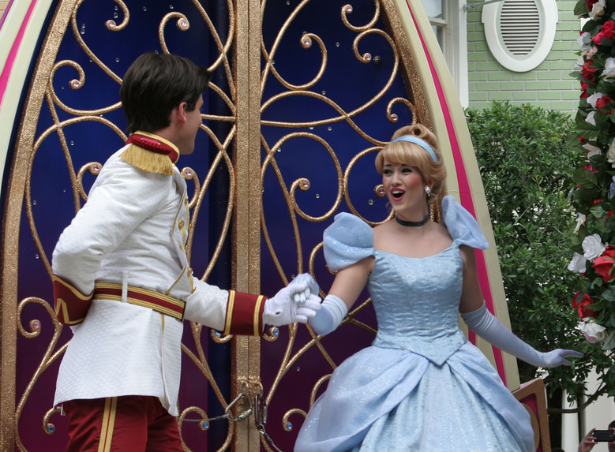
I agree that it isn’t that great to have a story where the one and only thing the girl wants is to go to the ball and marry the right man. She really isn’t the sort of powerful girl that many of us want in our stories - all she does is go to a dance and look fancy.

Slide 15
I think we should change what Cinderella wants, what she wishes for? We will have to think about what she could wish for besides going to the ball and marrying the handsome prince.
Maybe she wants something that will make
the world a better place. Maybe she wants
to save the dolphins. Or open a library. Or
give homes to the homeless!

Slide 16
Whichever option we decide, will have domino reactions that we have to remember.
For example, if the invitation was to a meeting to plan a new library, not a ball, then we’d need to decide if Cinderella’s job was to get the mean stepsisters ready for the meeting about the library, or maybe they wouldn’t even want to go. We would need to decide if she needed a fancy car and dress - what do you think?

Slide 17
So, do you see that first you think about a way to improve the original story?
Someone could decide to change an original fairy tale because they thought that fairy tales often take place in the country, so they might decide to write a city version.
What other ideas do you have?

Slide 18
Let’s update our list based on what we discovered today.
Ways Authors Adapt Fairy Tales
Changing the character
From a girl to a boy (or an animal)
From a fancy godmother to a less fancy one (dirty one)
Change the good guy to the bad guy or the bad guy to the good guy
Changing the events
From something old fashioned to something modern.
From something rich and fancy to something more people can relate to.
Changing the motivations
From wanting more money and power to wanting to do good in the world.

Slide 19
So think about your story and ask those important questions. What don’t you love about your fairy tale, if anything? How might you change it? You probably will come to different ideas.

Slide 20
Remember, it’s really important to make sure the changes you make are meaningful ones that lead to other changes.
One way to do that is to keep story elements in mind as you are thinking about what changes to make. Think about your characters. What do they want? What is in their way?

Slide 21
Here is my suggestion for the day. Get your plans down on your organizer. Don’t write plans as a story - don’t start it, “Once upon a time…” and tell everything bit by bit. Do write a lot of details about how things will go, and write in paragraphs.
It might sound like this, “In my story, there will still be a character named… and like in the classic story, she will still… When the story starts I am thinking she will…”
.

Slide 22
Problem The library will close if enough money is not raised to keep it open. The step sisters throw away the letter with the information, so Cinderella may not attend.
Cinderella Organizer
Characters
Cinderella
Stepsisters
Fairy Godmother
Setting
Stepsisters home
Library

Slide 23
Cinderella organizer
Event One
Letter arrives about a meeting to save the town’s library.
Details
Cinderella is still the stepsister who is treated like a servant. She loves reading.
A letter comes inviting them all to a fundraiser to save the town library.
The stepmother and stepsisters throw the letter away because they hate the library.

Slide 24
Cinderella organizer
Event Two
Cinderella is upset she cannot attend the fundraiser.
Details
Cinderella cries and her fairy godmother arrives.
The fairy godmother grants Cinderella’s wishes so Cinderella may go to the fundraiser.

Slide 25
Cinderella organizer
Event Three
Cinderella saves the library.
Details

Slide 26
Use the organizer form the blog.
Fill in The Three Little __________________________
Use the Cinderella adaptation organizer on the previous slides to as a model.

Slide 27
Does your story include a character who wants something?
Does your story have a character who runs into trouble, or who has a problem?
You have a few more minutes to think through and write about your plan for your story. If your plan is done, you could start listing character traits for your characters.

Slide 28
Writers, I have one more tip that I want to tell you. When you write your story tomorrow, you need to make sure that your adaptation doesn’t miss some of the super important parts of a good story.
So right now, will you get in your mind how
your adaptation is probably going to go?

