Slide 1
Mirror, Mirror on the Wall
Once Upon A Time

Slide 2
Some of you have discovered that writers spend a fair amount of their time not actually writing, but preparing to write and reflecting on their writing.
A really superb writer picks up their checklist,
even when no one suggests it, and rereads
their writing thinking, “Does this piece of
writing match the items on this checklist?”

Slide 3
Today I want to teach you that writers know that their writing gets better not only from what they do on the page, with their pen, but also from what they do off the page.
And no work is more powerful than being a really tough critic of one’s own draft, rereading one’s writing and judging it against goals in such a way that the writer comes away with goals to live by, stars to steer by.

Slide 4
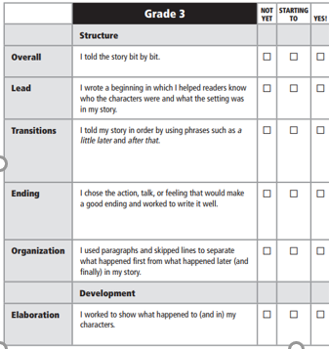
Let me show you what I mean. When I saw the checklist being used yesterday, the writer wasn’t just reading it without thinking. It can be easy to skim through it like this.
Check..
Yup…
I do that..
Uh huh…
Check..
I sort of do that too...

Slide 5
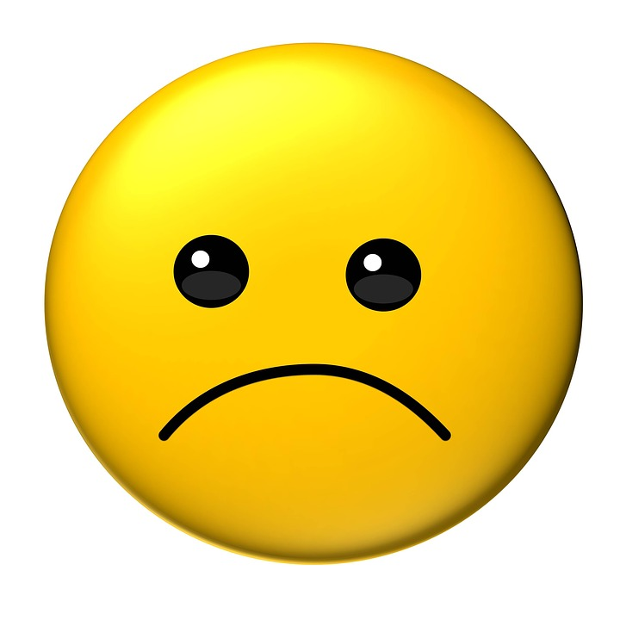
Do you think that kind of work is going to help me get better as a writer?

Slide 6
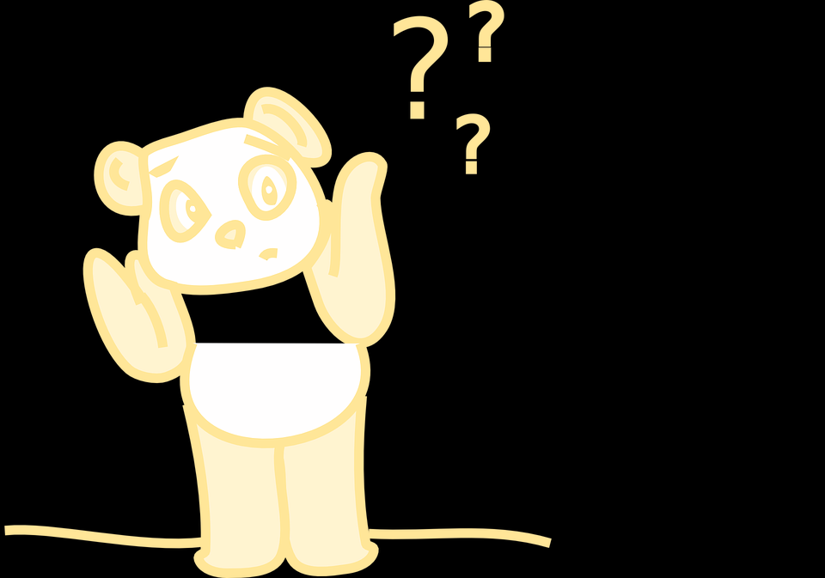
All of you know what it feels like to be deeply engaged in assessment and also know what it feels like to shrug and say, “it’s fine,” like I was doing earlier.
To become stronger writers, it’s important for you
to try the deeply engaged way of assessing your
work. As you are doing this work with your own
stories, you are not only thinking deeply about
those particular stories, you are thinking about
the stories you will work on in the future.

Slide 7
So writers, pull out your drafts and your Narrative Writing Checklist. As you read back and forth between the first few items on your checklist and your draft, don’t just read with that “eh” kind of energy and focus, but with a deeply engaged kind of focus.
Get started!

Slide 8
Writers, you can all make a mark alongside anything on the checklist that you want to work on in particular.

Slide 9
Writers, this is a long checklist, and it will be really important that you don’t just read the checklist but also read your writing to check on whether you really, truly tried to do each of these items in an exceptional way.
Label in your draft where you did things from the checklist.

